Slide 1
Data Visualization & Apriori Algorithm Implementation

Slide 2
Objective:
Analyze product purchase patterns
Implement Apriori algorithm.
Identify frequent itemset.
Generate strong association rules.
Visualize association rule.

Slide 3
Dataset Preparation Summary
Removed cancelled transactions
Removed negative quantities
Dropped missing Item names
Selected Top 500 products
Created Binary Basket Matrix

Slide 4
Apriori Algorithm Implementation
What is apriori algorithm?
Used for Market Basket Analysis
Finds frequent itemset
Generates association rules
Based on Support, Confidence & Lift

Slide 5
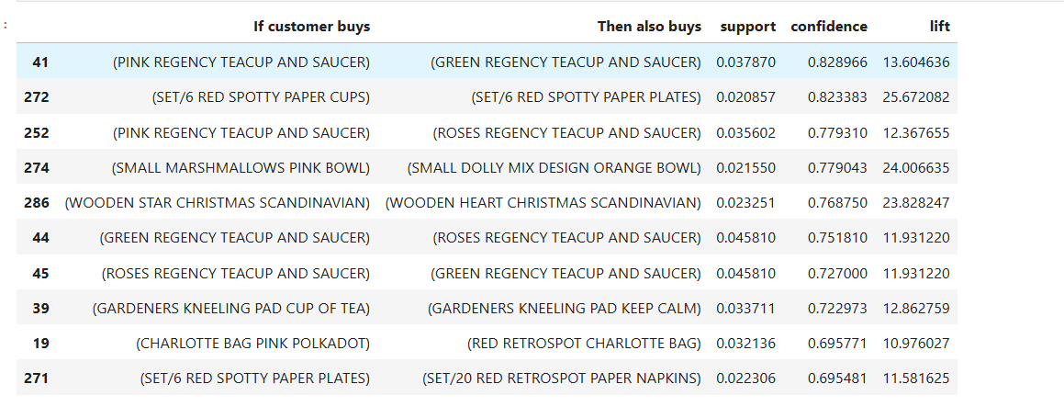
Frequent Itemset Identified
Table of Top Frequent Itemset:
Insights:
Customers often buy matching or same-theme products together, showing strong category-level associations.
High lift values (>10) indicate strong cross-selling opportunities, especially in decorative and gifting items.

Slide 6
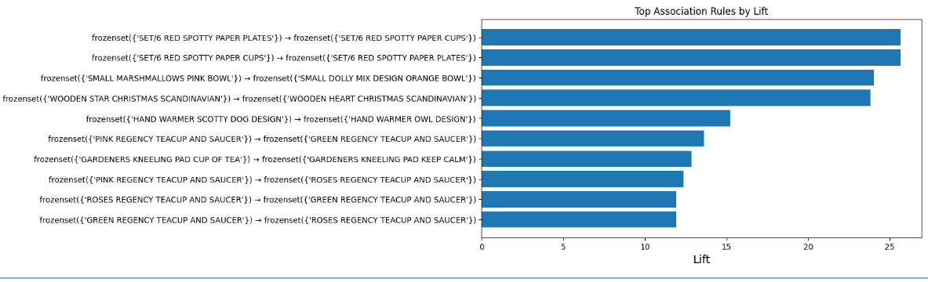
Lift Visualization
Horizontal Bar Chart of Top 10 Rules by Lift
Insights:
Product pairs with high lift values indicate a strong likelihood of being purchased together compared to random chance.
SET/6 Red Spotty Paper Plates and SET/6 Red Spotty Paper Cups show the highest lift, suggesting a strong complementary relationship.
Such high-lift product combinations can be effectively used for bundle offers, cross-selling, and store layout optimization.

Slide 7
Key Insights
Customers purchasing red spotty paper plates are highly likely to buy matching cups.
Regency teacup variants show strong cross-association.
Gift/combo items show higher lift values.
Complementary items should be placed together.

Slide 8
Business Recommendation
Bundle high-lift products
Cross-sell recommendations in online store
Cross-sell recommendations in online store
Create combo discounts
Create combo discounts

Slide 9
Conclusion
Apriori successfully identified strong product relationships
28 strong rules filtered
Market basket insights can improve sales strategy
Supports data-driven decision making

Slide 10
Technical Parameters Used
min_support = 0.004
confidence ≥ 0.6
lift ≥ 1.9
low_memory=True
Top 500 products considered

